Slide 1
PROJECT REVIEW
AI-Based Resume & Certificate
Authenticity Verification System
An end-to-end AI pipeline that reads, understands, cross-checks, and authenticates
academic and professional certificates using OCR, document AI, and tamper forensics.
GUIDED BY:-
Dr. KRISHNAKUMAR.K
professor
Presented by
RITHISH KUMAR D 192565089
A MOHAMMAD RIYAZ 192524375
SACHIN .R 192524280
BHARATH KUMAR 192511126
Combined Certificate Verification Dataset • 60 Certificates • 4-Module Pipeline

Slide 2
PROJECT OVERVIEW
Problem Statement & Approach
Why This Matters
Our Solution
Manual verification of resumes and certificates is slow, inconsistent, and easy to deceive
Fabricated credentials and edited PDFs/images are increasingly common in hiring and admissions
Institutions and recruiters lack a fast, automated, evidence-based way to confirm authenticity
A 4-module AI pipeline that reads, structurally understands, cross-verifies, and forensically checks each certificate
Combines OCR, Document AI (LayoutLM), object detection (YOLOv8), fuzzy matching, and tamper analysis
Outputs a clear verdict: VERIFIED or POSSIBLY TAMPERED, with supporting evidence
PROJECT ROADMAP — FOUR MODULES
1
2
3
4
OCR-Based Text Extraction
Layout, Logo & QR Intelligence
Issuer Cross-Verification
Tamper Detection & Decision Engine
PROJECT OVERVIEW
2

Slide 3
MODULE 1
1
OCR-Based Text Extraction
Objective
Automatically read every text field printed on a certificate image — Certificate ID, Candidate Name, Course Name, Issuing Organization, and Issue/Expiry Dates — and convert it into structured, machine-readable data.
Processing Pipeline
1
2
3
4
5
Certificate Image
Pre-processing
PaddleOCR Engine
Field Mapping
Structured JSON
PNG input, 1100×780px
Denoise, deskew, binarize (OpenCV)
Text detection + recognition
Raw text → labeled key fields
Ready for Module 2 & 3
Fields Extracted per Certificate
Certificate ID • Candidate Name • Course Name
Issuing Organization • Issue Date • Expiry Date
MODULE 1 — OCR-BASED TEXT EXTRACTION
3

Slide 4
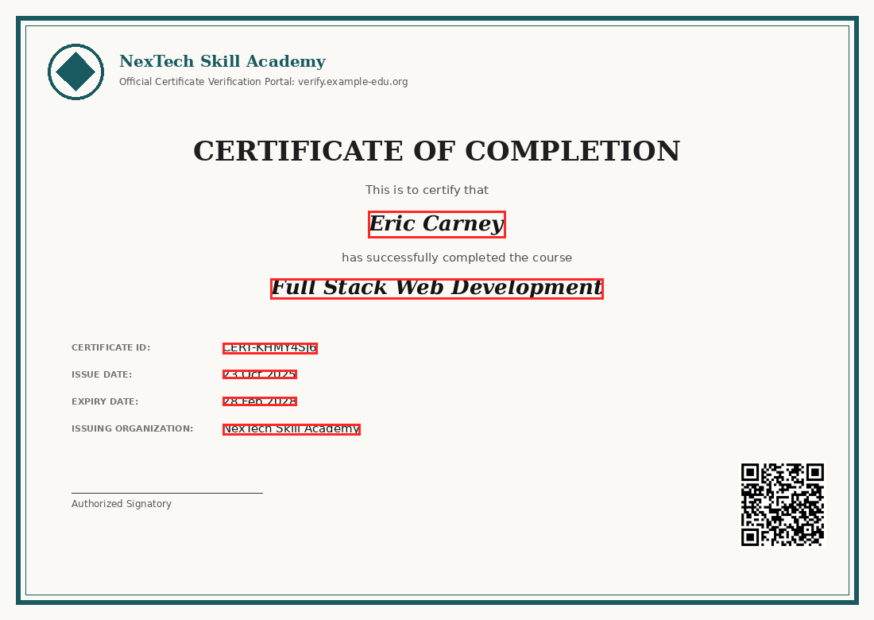
MODULE 1 · DATASET
1
Dataset Example — Certificate Image & OCR Fields
annotations/CERT-KHMY4SJ6.json → ocr_fields
"Certificate ID": "CERT-KHMY4SJ6"
"Candidate Name": "Eric Carney"
"Course Name": "Full Stack Web Development"
"Issuing Organization": "NexTech Skill Academy"
"Issue Date": "23 Oct 2025"
"Expiry Date": "28 Feb 2028"
Each field is stored with its (x, y) bounding box, in FUNSD / LayoutLM-style format — ready for both OCR training and downstream layout parsing.
Detected text regions
images/CERT-KHMY4SJ6.png — red boxes = OCR-detected field regions
MODULE 1 — OCR-BASED TEXT EXTRACTION
4

Slide 5
MODULE 1 · IMPLEMENTATION
1
Implementation Approach
Tech Stack
Why PaddleOCR
PaddleOCR — multilingual detection + recognition engine
OpenCV — deskewing, denoising, contrast normalization
Regex + rule-based field classifier for label matching
Output normalized to the same schema as issuer_records.csv
Strong accuracy on printed document text vs. general OCR
Lightweight enough for real-time verification requests
Returns per-word bounding boxes needed for tamper localization
Open-source, extensible to handwritten resume text later
Sample Extraction Output
Field | Extracted Value | Confidence
Certificate ID | CERT-KHMY4SJ6 | 98.7%
Candidate Name | Eric Carney | 97.2%
Issuing Organization | NexTech Skill Academy | 96.5%
Issue Date | 23 Oct 2025 | 99.1%
MODULE 1 — OCR-BASED TEXT EXTRACTION
5

Slide 6
MODULE 2
2
Layout, Logo & QR Intelligence
Objective
Go beyond raw text: understand the certificate's structure, confirm the issuing institution's logo is genuine, and decode the embedded QR code that links to the issuer's verification portal.
Three Parallel Sub-Pipelines
1
2
3
LayoutLMv3
YOLOv8
QR Decoder
Field-Value Understanding
Logo Detection
Link Verification
Learns spatial + textual relationships between labels and their values (key-value pairing)
Detects & classifies the issuer logo (5 classes) to confirm the institution is genuine
Decodes embedded QR to fetch and cross-check the issuer's official verification URL
MODULE 2 — LAYOUT, LOGO & QR INTELLIGENCE
6

Slide 7
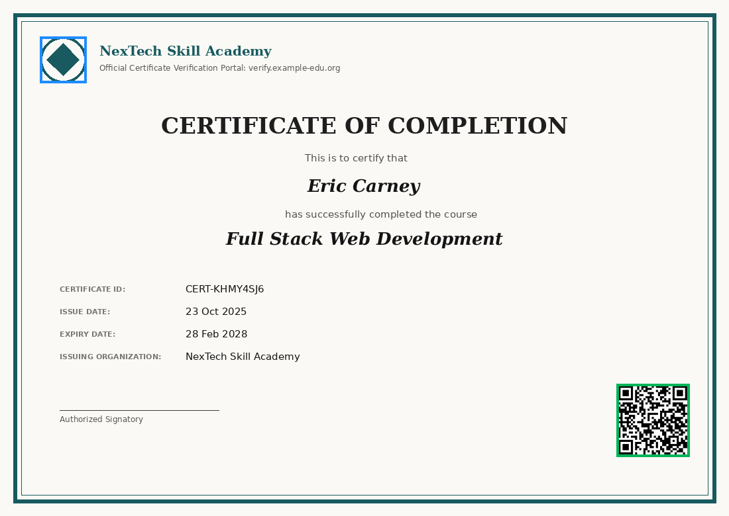
MODULE 2 · DATASET
2
Dataset Example — Logo & QR Annotations
YOLOv8 Label Format (yolo_logos/CERT-55NF4ZW9.txt)
4 0.086364 0.115385 0.063636 0.089744
class_id x_center y_center width height (normalized 0–1)
classes.txt → nextech_logo, globallearn_logo, brightpath_logo, summit_logo, vertex_logo
annotations/*.json → "qr_code"
"bbox": [930, 580, 1040, 690], "decoded_url": "https://verify.example-edu.org/
certificate/CERT-KHMY4SJ6"
Logo bbox (blue)
QR bbox (green)
The decoded URL is pinged to confirm the issuer's portal recognizes the certificate ID.
images/CERT-KHMY4SJ6.png annotated with logo & QR regions
MODULE 2 — LAYOUT, LOGO & QR INTELLIGENCE
7

Slide 8
MODULE 2 · IMPLEMENTATION
2
Implementation Approach
LayoutLMv3
YOLOv8 (Logo Detection)
QR Code Verification
Fine-tuned on annotations/*.ocr_fields (text + bbox pairs)
Jointly embeds text, layout position & image patches
Predicts label-value linkage even when layout varies by issuer template
Outputs the key-value schema consumed by Module 3
Trained on yolo_logos/ using standard YOLO bbox format
5-class detector: NexTech, GlobalLearn, BrightPath, Summit, Vertex
Flags certificates whose logo class doesn't match the claimed issuing_organization field
Runs in real time (single forward pass per image)
pyzbar / OpenCV QRCodeDetector decodes qr_code.bbox region
Resolved URL pattern: verify.example-edu.org/certificate/{id}
Checks the decoded certificate ID matches the OCR-extracted ID
Missing / undecodable QR is treated as a red-flag signal downstream
MODULE 2 — LAYOUT, LOGO & QR INTELLIGENCE
8

Slide 9
MODULE 3
3
Issuer Cross-Verification
Objective
Confirm that what the certificate claims actually exists in the issuing institution's official record — not just that the image looks legitimate.
Verification Flow
1
2
3
4
5
OCR Output
Issuer Lookup
RapidFuzz Matching
Match Decision
Verification Score
extracted_by_ocr_pipeline{}
issuer_records.csv by Certificate ID
Field-by-field similarity scoring
Pass / flag per field
Forwarded to Module 4
Why Fuzzy Matching (Not Exact Match)
OCR is imperfect — minor character noise ("Nex7ech" vs "NexTech") shouldn't fail a genuine certificate
RapidFuzz token-level similarity absorbs small OCR errors while still catching real discrepancies
MODULE 3 — ISSUER CROSS-VERIFICATION
9

Slide 10
MODULE 3 · DATASET
3
Dataset Example — Issuer Records vs. Extracted Data
issuer_records.csv (official database Module 3 checks against)
Certificate ID | Candidate Name | Course Name | Issuing Organization
CERT-XAJI0Y6D | Allison Hill | Data Structures & Algorithms | Summit Online University
CERT-BHSAHXTH | Stephanie Miller | Digital Marketing Essentials | Vertex Professional Training
CERT-3A3ZMF8M | Jonathan Johnson | Cybersecurity Basics | NexTech Skill Academy
Cross-Match Example — CERT-B4GH2M5Z
Field | OCR-Extracted | Issuer Record | Similarity
Candidate Name | Richard Henson | Richard Henson | 100%
Course Name | Embedded Systems Design | Embedded Systems Design | 100%
Issue Date | 06 May 2025 | 02 May 2025 | 71% ⚠
Reading the Result
A low-similarity field (like the Issue Date above, from the dataset's real tampered sample) is flagged and passed to Module 4 as tamper evidence
MODULE 3 — ISSUER CROSS-VERIFICATION
10

Slide 11
MODULE 3 · IMPLEMENTATION
3
Implementation Approach
Tech Stack
Matching Logic
RapidFuzz (Python) — token_sort_ratio / WRatio for string similarity
Pandas — indexed lookup of issuer_records.csv by Certificate ID
Per-field configurable similarity threshold (e.g. ≥ 90% = pass)
Date fields parsed & compared logically, not just as strings
Certificate ID must exist in issuer_records.csv — else instant reject
Each remaining field gets a 0–100 similarity score
Any field below threshold is logged with its score as evidence
An aggregate verification_score is passed to the decision engine
Similarity Scoring Snapshot
Candidate Name
100%
Course Name
100%
Issuing Organization
100%
Issue Date
71%
MODULE 3 — ISSUER CROSS-VERIFICATION
11

Slide 12
MODULE 4
4
Tamper Detection & Decision Engine
Objective
Detect pixel-level image forgery (edited text, pasted regions) and fuse every module's evidence into one final, explainable verdict.
Fusion Pipeline
1
2
3
4
5
Tamper Localization
OCR Evidence
Logo / QR Evidence
Issuer Match Score
Final Verdict
Mask prediction on image
Module 1 field confidence
Module 2 flags
Module 3 similarity
VERIFIED / POSSIBLY TAMPERED
Ground-Truth Basis
45 genuine + 15 tampered certificates, each labeled with ground_truth_verdict in metadata.csv
Tampered fields are limited to the highest-value targets: Candidate Name, Certificate ID, Issue Date
MODULE 4 — TAMPER DETECTION & DECISION ENGINE
12

Slide 13
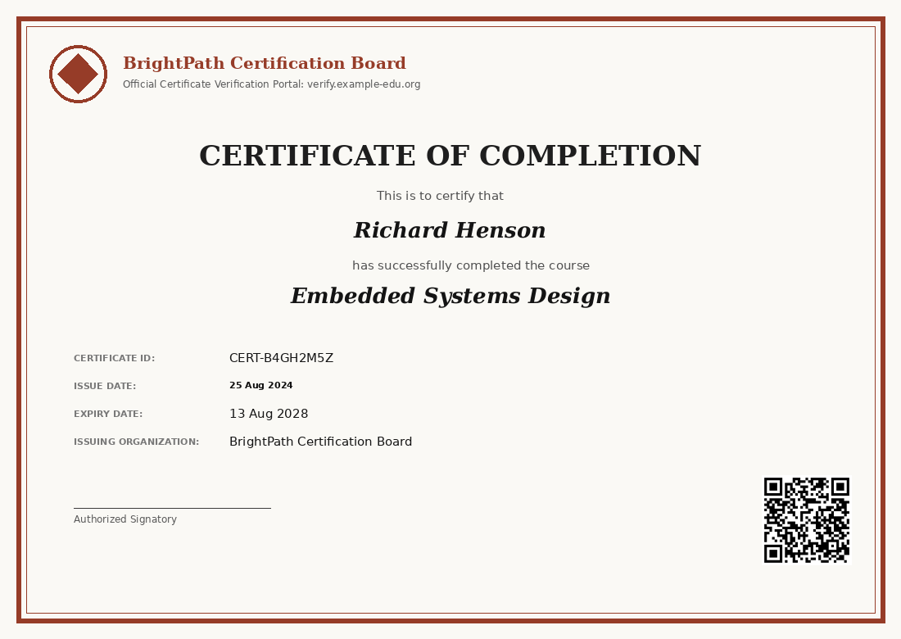
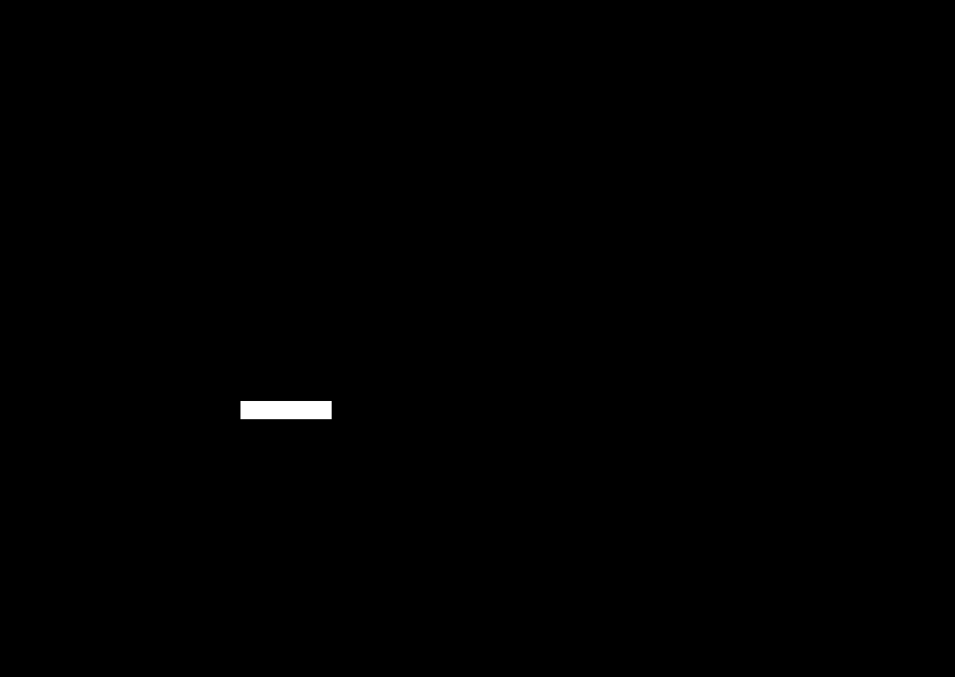
MODULE 4 · DATASET
4
Dataset Example — Tampered Certificate & Mask
images/CERT-B4GH2M5Z.png (Issue Date edited)
tampered/CERT-B4GH2M5Z_mask.png (ground-truth tamper mask)
metadata.csv → ground_truth_verdict
Certificate ID | Tampered Field | Verdict
CERT-P89UZFK8 | — | VERIFIED
CERT-B4GH2M5Z | Issue Date | POSSIBLY TAMPERED
MODULE 4 — TAMPER DETECTION & DECISION ENGINE
13

Slide 14
MODULE 4 · IMPLEMENTATION
4
Implementation Approach
Tamper Localization
Decision Engine
DocTamper-style binary mask prediction (CNN / ELA-based) highlights edited pixel regions
Trained against tampered/*_mask.png ground truth
Outputs a tamper heatmap + is_tampered confidence score
Weighted rule engine fuses: OCR confidence + logo/QR checks + issuer similarity + tamper score
Certificate ID missing from issuer DB → auto-reject
Any field below similarity threshold OR tamper mask hit → POSSIBLY TAMPERED
All checks pass → VERIFIED
Final Verdict Logic
✓ VERIFIED
⚠ POSSIBLY TAMPERED
Certificate ID found in issuer_records.csv, all fields match ≥ threshold, no tamper mask detected, logo & QR confirmed.
One or more fields fall below the similarity threshold, or the tamper-localization model flags an edited pixel region.
MODULE 4 — TAMPER DETECTION & DECISION ENGINE
14

Slide 15
Thank You
Questions & Discussion
1. OCR-Based Text Extraction
2. Layout, Logo & QR Intelligence
3. Issuer Cross-Verification
4. Tamper Detection & Decision Engine
AI-Based Resume & Certificate Authenticity Verification System

